Slide 1
Multi-Switch Cooperative Sketch-based Monitoring
Wei-Te Lu 呂韋德
Advisor：Ching-Ju Lin 林靖茹
Shiao-Li Tsao 曹孝櫟

Slide 2


Network Measurement
Foundation for network applications
Network Measurement
Network Monitoring
Network Security
Analysis
Defense
Notes:
在一個網路系統當中，網路量測扮演著一個十分重要的腳色。因為對於諸多網路應用以及管理來說，量測是他們不可或缺的基礎，像是網路狀態的監控或者是網路安全的防禦等等，都需要仰賴網路量測的結果，來做出相對應的分析或者是反應。
因此，為了讓這些application可以正常運作，量測的方法是十分重要且不可或缺的

Slide 3



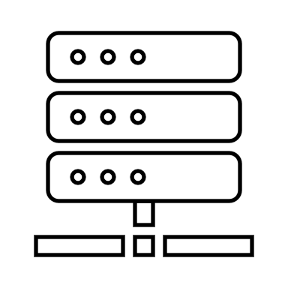


Existing Measurement Methods
Hash-based
4+1 | 52 | 31
5 | 20 | 3+1
14 | 2+1 | 9
74+1 | 3 | 6
h1(.)
h2(.)
F2
F1
h3(.)
h4(.)
sample
flow
flow
flow
Sample
Sketch
Network Measurement
Notes:
那麼，目前量測的方法 大概可以分成以下兩種
首先 第一種是sample based的方法，在這類方法中，他們會從flow 中sample packet出來累計量測，但是為了維持一定的準確度，往往這類方法都需要相當大的sampling rate ，
而如此一來，會造成諸如cpu 或者是bandwidth等等系統龐大的overhead
而與之相反的另一種方法則是sketch based的方法 ，在這類方法中，他們普遍會放一個hash-based data structure在switch中累計量測，每當有packet進來時 則利用hash flow id的方式更新相對應格子的值， 如此一來既能利用調整memory用量的方式來維持準確度，又不會給系統帶來龐大的overhead
因此目前考量到overhead跟準確度的關係，所以主流的量測常常都是使用sketch based的方法

Slide 4
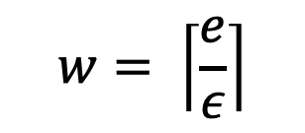
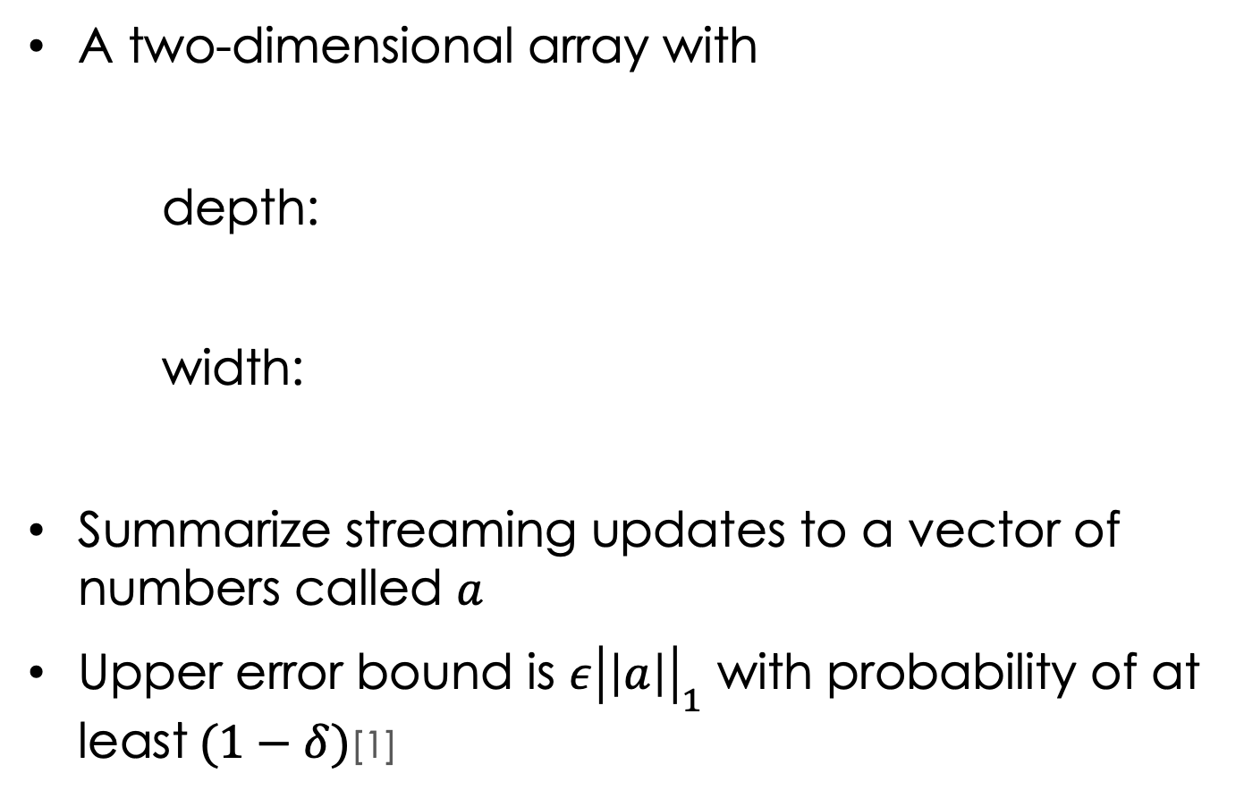
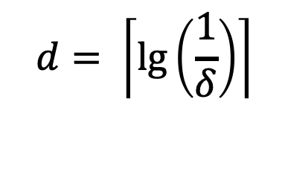
Sketch
A two-dimensional array with
depth:
width:
Summarize streaming updates to a vector of numbers called $a$
Upper error bound is $ε{\left|\left|a\right|\right|}_{1}$ with probability of at least$(1−δ)$[1]
w=3
$$d= \left\lceil \lg\left(\frac{1}{δ}\right)\right\rceil$$
h1(.)
0 | 0 | 0
0 | 0 | 0
0 | 0 | 0
0 | 0 | 0
h2(.)
d=4
$$w= \left\lceil \frac{e}{ε}\right\rceil$$
h3(.)
h4(.)
[1]G. Cormode and S. Muthukrishnan. An improved data stream summary: The count-min sketch and its applications. Journal of Algorithms, 55(1):58–75, 2005. Conference version in Proceedings of Latin American Theoretical Informatics (LATIN), 2004. Initial Technical Report published as DIMACS 2003-20, June 2003.

Slide 5
CM-Sketch(Count Min)
Insert
Query
0+1 | 0 | 0
0 | 0 | 0+1
0 | 0+1 | 0
0+1 | 0 | 0
0 | 0 | 0
0 | 0 | 0
0 | 0 | 0
0 | 0 | 0
h1(.)
h2(.)
Update the hashed bucket of each row
F2
F1
h3(.)
h4(.)
4 | 52 | 31
5 | 20 | 3
14 | 2 | 9
74 | 3 | 6
h1(.)
Flow ID (or 5-turple)
h2(.)
Packet count of flow (5-turple) = min(4,3,2,74) = 2
h3(.)
h4(.)

Slide 6
Sketch-Based Monitoring
Sketch based
Count-Min(CM) Sketch [1]
Count Sketch [2]
Univmon [3]
……
Hybrid Sketch Algorithm
Elastic Sketch [4]
HybridSketch [5]
……
[2]M. Charikar, K. Chen, and M. FarachColton, “Finding frequent items in data streams,” in Proceedings of the International Colloquium on Automata, Languages and Programming, 2002.
[3]Z. Liu, A. Manousis, G. Vorsanger, V. Sekar, and V. Braverman, “One sketch to rule them all: Rethinking network flow monitoring with UnivMon,” in ACM SIGCOMM, 2016.
[4]T. Yang, J. Jiang, P. Liu, Q. Huang, J. Gong, Y. Zhou, R. Miao, X. Li, and S. Uhlig, “Elastic sketch: Adaptive and fast networkwide measurements,” in ACM SIGCOMM, 2018. [5]X. Zhao, M. Wen, M. Tang, Q. Huang, and C. Zhang, “HybridSketch: A memorycentric precise approach for flow measurement,” in IEEE ICC, 2020.

Slide 7
Sketch-Based Monitoring
Pros
Memory & Accuracy Tradeoff
Efficiency
Generality [Univmon, Sigcomm16]
Notes:
隨著sketch逐漸成為主流量測監控的方法，這類的演算法也越來越多元，雖然他們設計的目的各有所不同，但是他們相較於其他測量方法都有三個共同的優點 首先，
第一點，普遍sketch都具備理論上可以證明的，準確度與記憶體使用量的平衡特性，所以他們可以在只占用少量的空間資源情況下，提供卓越的準確度
其次，因為他們的演算法沒有過多複雜的運算過程，所以即使在高速的網路環境當中，也可以比其他演算法更有效地儲存累計flow 的訊息量
最後，近年來這類的研究，都漸漸追求讓sketch可以更general，使得一套演算法可以同時處理多種的量測項目

Slide 8






Sketch-Based Monitoring
Cons
Collision
Overloaded per switch
F1
0 | 0 | 0 | 0 | 0 | 0
0 | 0 | 1 | 0 | 0 | 0
0 | 0 | 2 | 0 | 0 | 0
F2

Slide 9
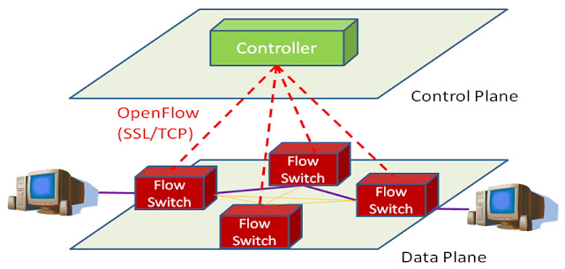

Sketch-Based Monitoring

Slide 10




Per-Switch Monitoring
F2
F1
F4
F3
☹ Each switch is overloaded
☹ Many switches experience collisions

Slide 11
Cooperative Monitoring
F2
F1
F4
F3
☺ Offload monitoring load across switches
☺ Lower collision probability per switch

Slide 12



Traditional Way
這兩頁我在聽你講一下
圖我覺得太複雜
應該可以畫一個fat-free
然後畫兩個flow 走一樣的路
傳統的方法都在一個switch (or 每個switch)做sketch 然後說會碰撞就好
F4
F3
F2
F1
718 | 2041 | 262 | 593 | 362 | 903
F4
F3
F2
F1
S1
S3
705 | 2031 | 242 | 793 | 462 | 803
F4
F3
F2
F1
703 | 2231 | 442 | 393 | 862 | 603
F4
F3
F2
F1
S2
S4
765 | 1831 | 212 | 693 | 562 | 903

Slide 13

Ideal Way
F3
18 | 41 | 262 | 93 | 32 | 93
F1
S1
S3
70 | 87 | 12 | 79 | 42 | 83
F4
703 | 31 | 42 | 33 | 62 | 63
F2
S2
S4
75 | 31 | 22 | 23 | 562 | 63

Slide 14






Goal
Multi-Switch Cooperative Monitoring
Alleviate the degree of collisions
Reduce the Relative Error(RE) of all flows
Enhance efficiency of packet processing

Slide 15
Challenges
How to assign flows to switches?
Distribute monitoring load across switches
Jointly consider routing to enhance offloading opportunities
How to provide heterogeneous monitoring resolutions for different flows?
More important flows, higher monitoring precision
Notes:
要設計一個合作式平台需要解決兩個問題
首先我們要先決定如何幫每個flow選定適當的switch(來追蹤流量)，確保每個flow都能被適當的追蹤
另外我們也需要綜合考慮flow的路由機制，讓所有switch能有更多的機會去平攤追蹤的負擔
另外因為每個flow的大小和重要性不同，我們也需要探討如何提供不同flow異質化的追蹤可靠度。理想上，我們希望越重要的flow能夠獲得更多switch的資源來達到較高的追蹤準確度

Slide 16
Outline
Overview
Design
Performance Evaluation
Conclusion

Slide 17
Problem Statement
Input
A set of switches and a set of flows
Task
Determine the routing path of flows
Determine the monitoring switches of each flow
Objective
Minimize the WRE(Worst Relative Error) of all flows

Slide 18
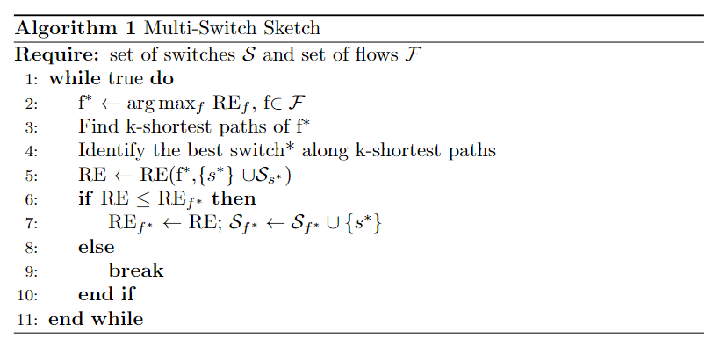

Slide 19
Flow Chart
End
No
Can its RE be lowered?
Yes
Compute the RE of flow
Flow selection
Switch selection
Choose the worst Flow
Choose the best path
Path selection

Slide 20
Questions
1. How to calculate multi-switch RE of flow f ?
2. How to find the best switch along k-shortest path ?
3. How to query across cooperative switches ?

Slide 21
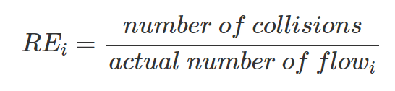
Calculate Multi-Switch RE of Flow f
Relative Error(RE)
How to evaluate the performance of cross-switch RE of a flow?

Slide 22


Cross-switch RE of a flow
How to evaluate the performance of cross-switch RE of a flow?
h1(.)
4 | 52 | 31
5 | 20 | 3
14 | 2 | 9
74 | 3 | 6
h2(.)
h3(.)
h4(.)
192.168.1.1
RE = min{4,5} = 4
h1(.)
45 | 23 | 14
55 | 80 | 43
18 | 29 | 37
74 | 5 | 18
h2(.)
h3(.)
h4(.)

Slide 23
Best switch along k-shortest path
Routing Algorithm
Shortest path
Longest path
K-shortest path

Slide 24


Path Selection
Naïve way: Shortest Path
Every flow use the same path
Set of switch
={s1,s2,s3}
S4
S5
S6
S7
Set of switch
={s1,s2,s3}
Set of switch
={s1,s2,s3}
S1
S2
S3

Slide 25
Path Selection
Naïve way: Longest Path
Go through all switch

Slide 26
Problem
Shortest path
Switch congestion → flow errors
Longest path
Higher offloading opportunity → Routing overhead

Slide 27
Path Selection
K-Shortest path
Yen's Algorithm[6]
Use path loading and switch to choose best path
S4
S5
S6
S7
Set of best k-path
={[s1,s2,s3]}
First Path
={s1,s2,s3}
S1
S2
S3
[6] Jin Y. Yen “FINDING THE K SHORTEST LOOPLESS PATHS IN A NETWORK*, 2009.

Slide 28
K-Shortest path
Set of best k-path
={[s1,s2,s3]}
S4
S5
S6
S7
First Path
={s1,s2,s3}
S1
S2
S3
Turn 1
={}

Slide 29
K-Shortest path
Set of best k-path
={[s1,s2,s3]}
S4
S5
S6
S7
First Path
={s1,s2,s3}
S1
S2
S3
Turn 1
={}
Turn 1
={[s1,s6,s7,s3]}

Slide 30
K-Shortest path
Set of best k-path
={[s1,s2,s3]}
S4
S5
S6
S7
First Path
={s1,s2,s3}
S1
S2
S3
Turn 1
={[s1,s6,s7,s3]}

Slide 31
K-Shortest path
Set of best k-path
={[s1,s2,s3],
[s1,s6,s7,s3]}
S4
S5
S6
S7
second Path
={s1,s6,s7,s3}
S1
S2
S3
Turn 2
={ }

Slide 32
K-Shortest path
Set of best k-path
={[s1,s2,s3],
[s1,s6,s7,s3]}
S4
S5
S6
S7
second Path
={s1,s6,s7,s3}
S1
S2
S3
Turn 2
={ }

Slide 33
K-Shortest path
Set of best k-path
={[s1,s2,s3],
[s1,s6,s7,s3]}
S4
S5
S6
S7
second Path
={s1,s6,s7,s3}
S1
S2
S3
Turn 2
={ }

Slide 34
K-Shortest path
Set of best k-path
={[s1,s2,s3],
[s1,s6,s7,s3]}
S4
S5
S6
S7
second Path
={s1,s6,s7,s3}
S1
S2
S3
Turn 2
={ }

Slide 35
Path Selection
Flow1
Flow2
Flow3
Set of switch
={s1,s2,s3}
S4
S5
S6
S7
Set of switch
={s1,s4,s5,s3}
Set of switch
={s1,s6,s7,s3}
S1
S2
S3

Slide 36
Query Across Cooperative Switches
4 | 52 | 31
5 | 20 | 3
14 | 2 | 9
74 | 3 | 6
192.168.1.1
45 | 23 | 14
55 | 80 | 43
18 | 29 | 37
74 | 5 | 18

Slide 37
Multi-Switch Sketch

Slide 38


Slide 40


Slide 41
Can’t find better switch

Slide 43
Outline
Overview
Algorithm
Performance Evaluation
Conclusion

Slide 44
Comparison Schemes and Metrics
Baseline schemes
CM sketch : Original CM sketch
Best one in shortest path(Shortest): Store in one switch that on the path using Dijkstra
Best one in all topology(All): Store in one switch that is best in the topology
Performance metrics
WRE(Worst Relative Error)

Slide 45
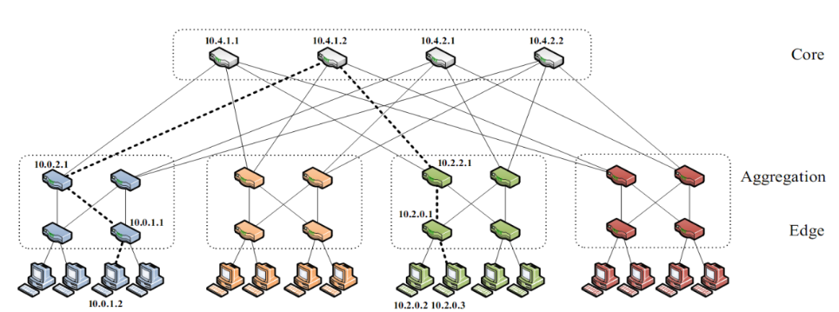


Topology
K-Ary Fat Tree
K = 6, K = 4
K = 4-1 , k = 4-2 , k = 4-3

Slide 46
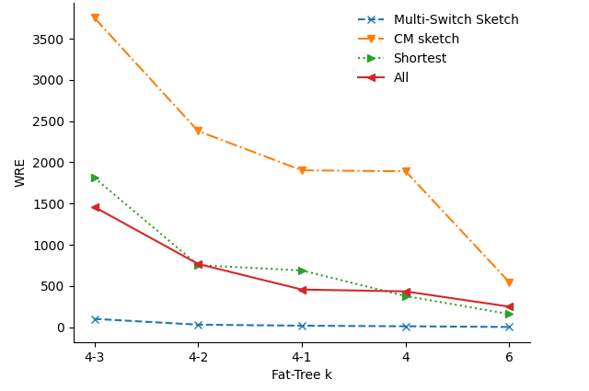
WRE with Different Topology
Sketch d = 5,w = 3
Multi-Switch Sketch perform well in every topology

Slide 47

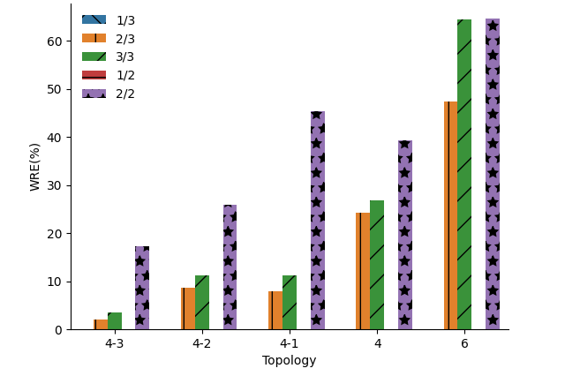
Heterogeneous Monitoring Resolutions
More important flows, higher monitoring precision

Slide 48
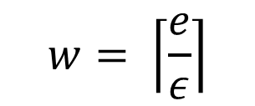
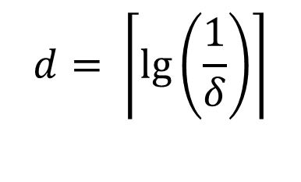
Memory Usage
D = 5(95%), w = 3(0.9), w = 6(0.45), w = 9(0.3)
D = 6, w = 9
$$d= \left\lceil \lg\left(\frac{1}{δ}\right)\right\rceil$$
$$w= \left\lceil \frac{e}{ε}\right\rceil$$

Slide 49
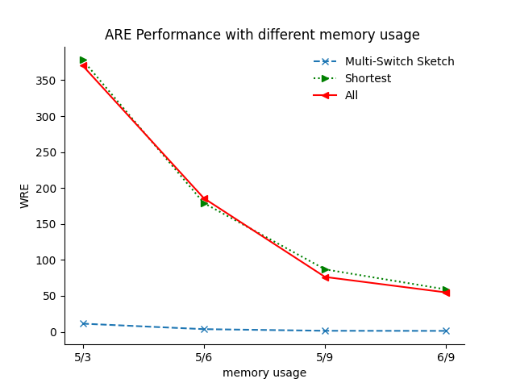
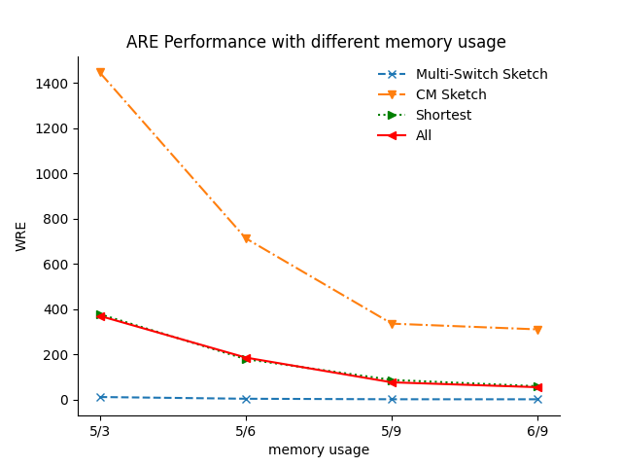
Impact of Memory Sizes
Multi-Switch Sketch perform well in every memory size

Slide 50
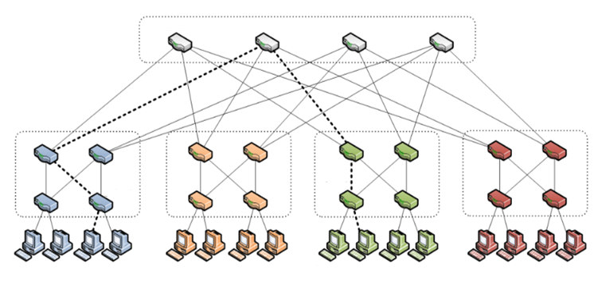
Traffic
Change the location of Src and Dst

Slide 51
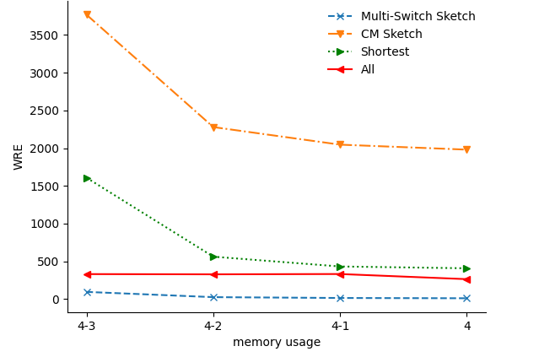
Flow Assignment Distribution
Multi-Switch Sketch can conquer flow congestion

Slide 52
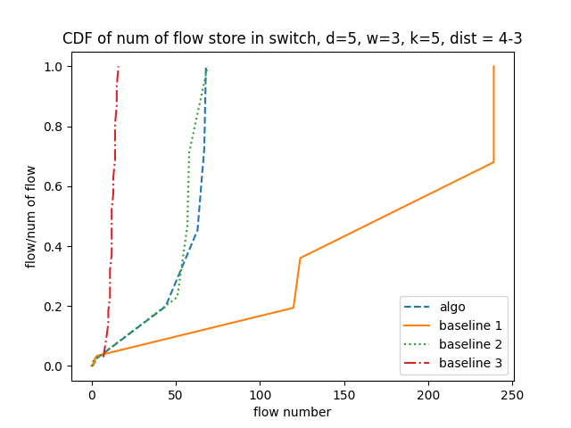
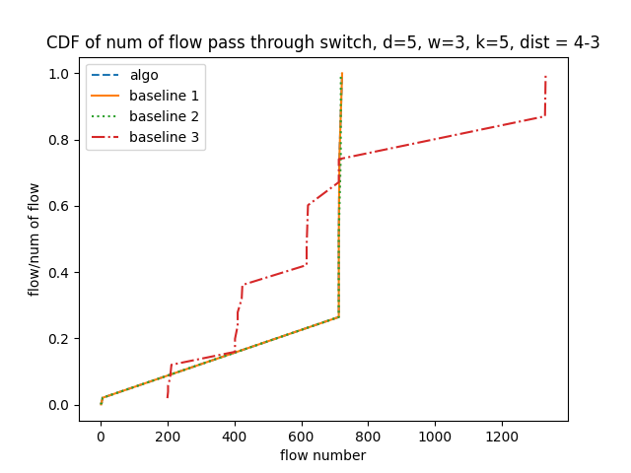
Flow Assignment Distribution

Slide 53
Outline
Overview
Algorithm
Performance Evaluation
Conclusion

Slide 54
Conclusion
Multi-Switch Sketch:
Improve the situation of collision
Improve the WRE of all Flows
Enhance efficiency of switch process packets
Can perform in different environment

Slide 55
Thank you for listening!

